Slide 1

Taxi Hubs
CS 777 Project
By:
Aaron T.

Slide 2

Background
For this project I will explore how K-means clustering could be beneficial to taxi drivers around New York City by creating hubs around the pickup points with the largest trip distance. I believe this could lead to maximizing their profit per ride.
Data source: York City Taxi trip reports from 2013

Slide 3
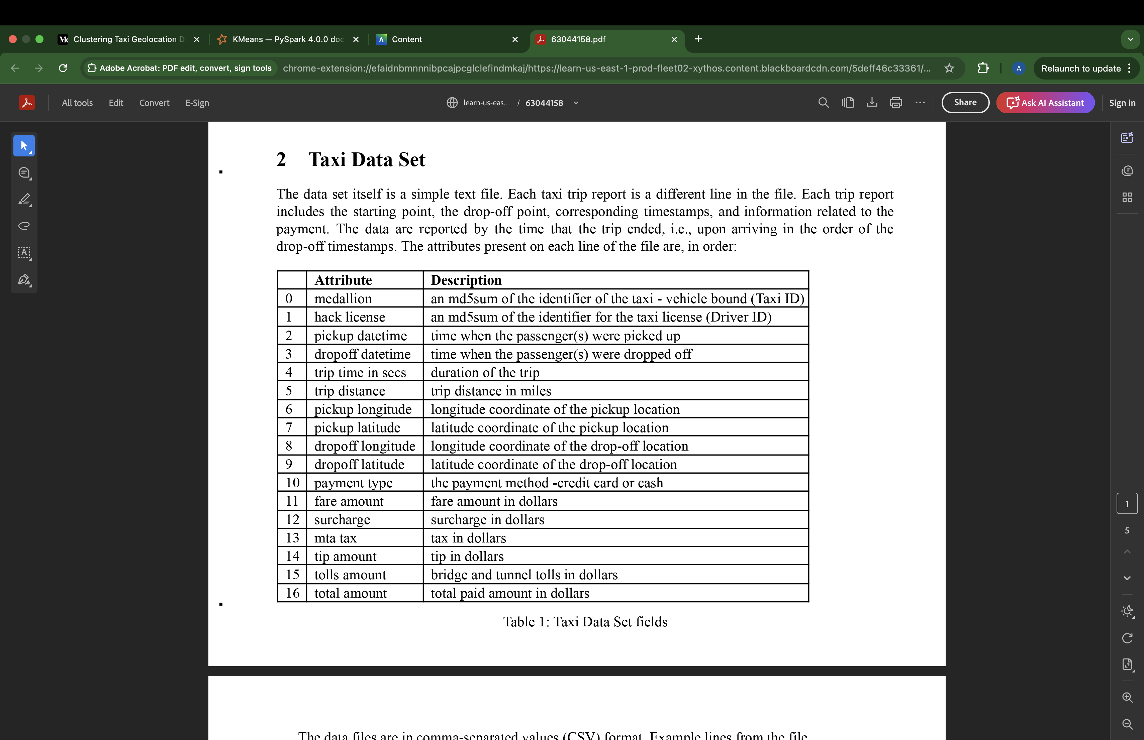
Dataset Features

Slide 4
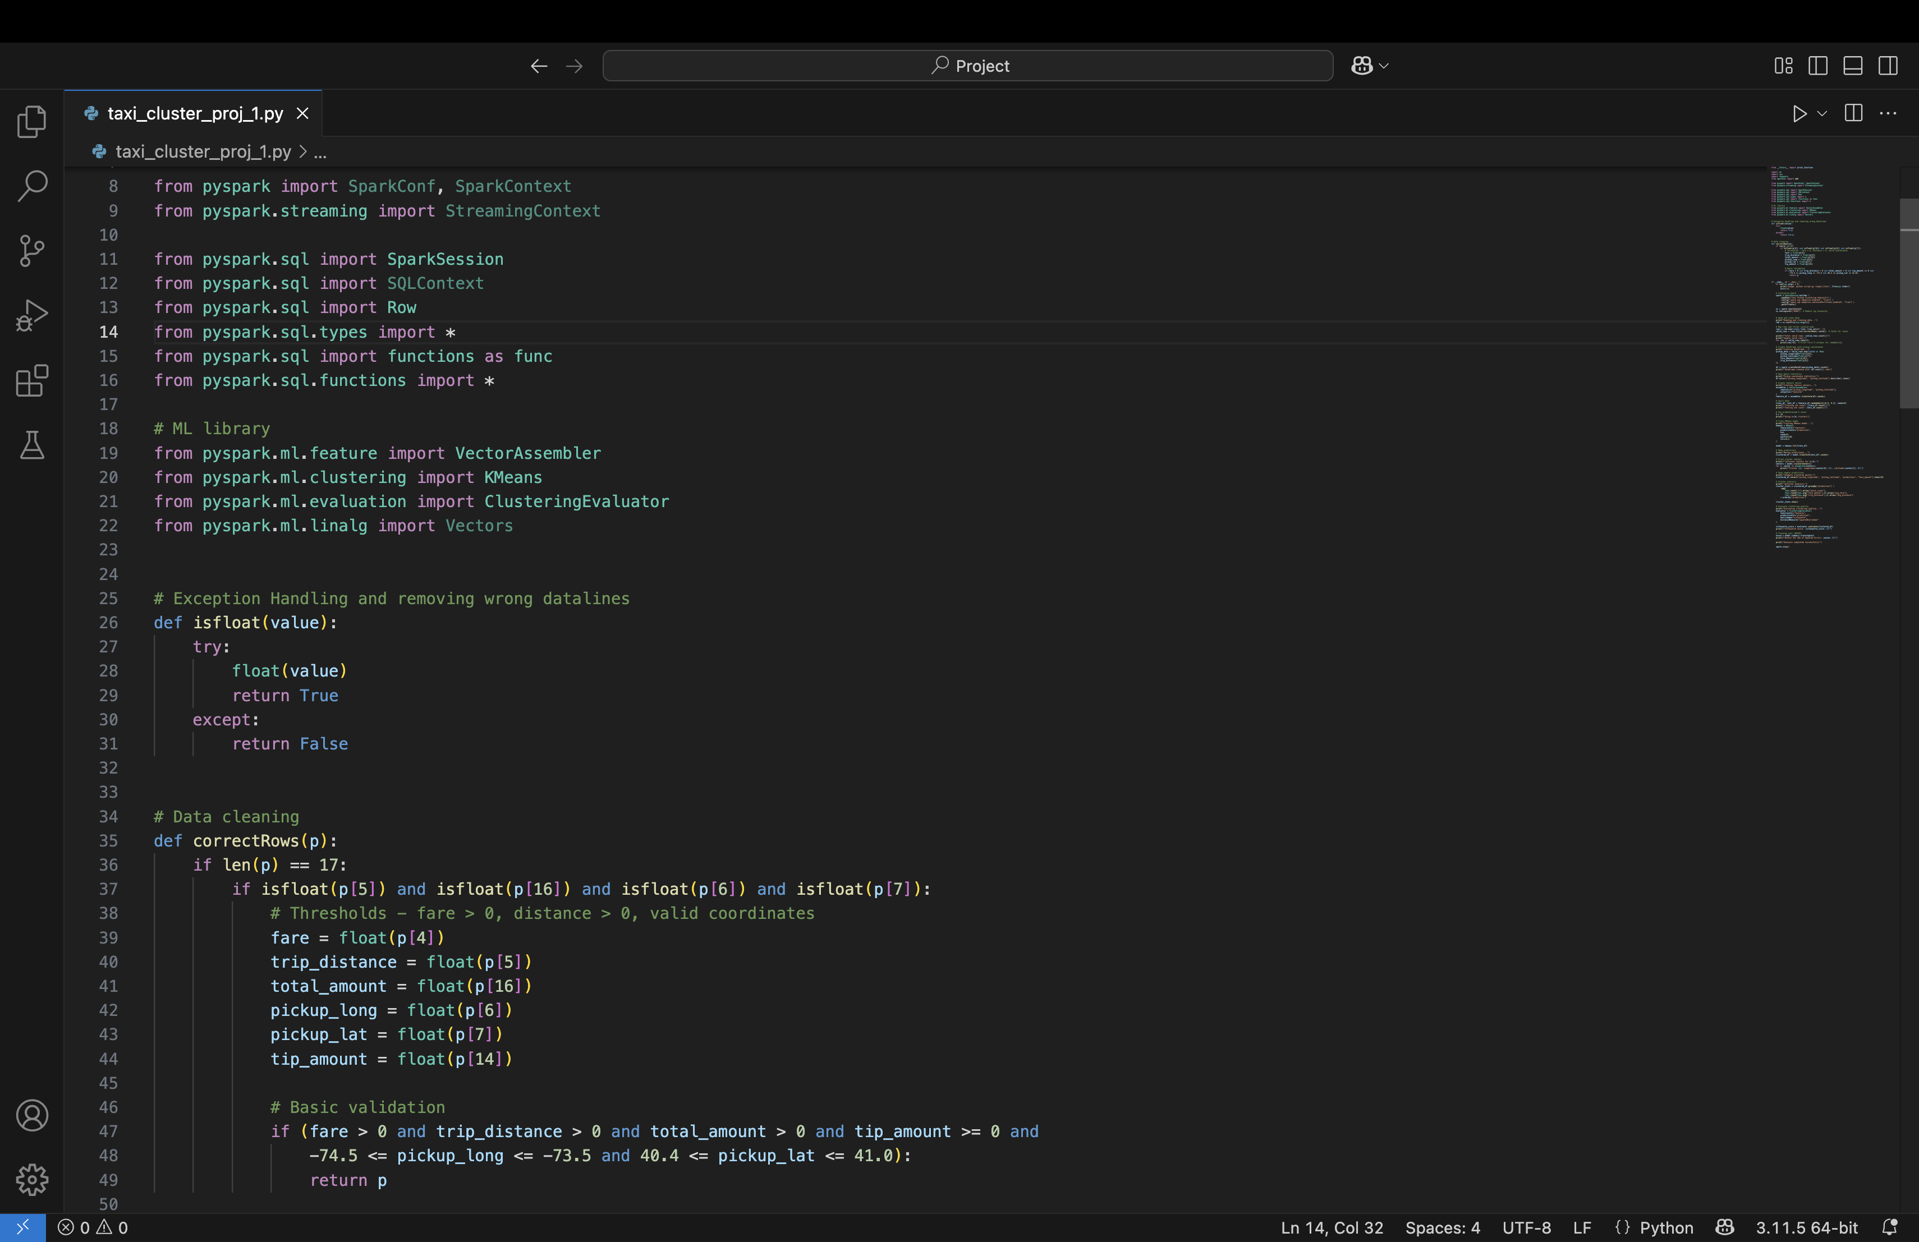
Data Cleaning & Filtering

Slide 5
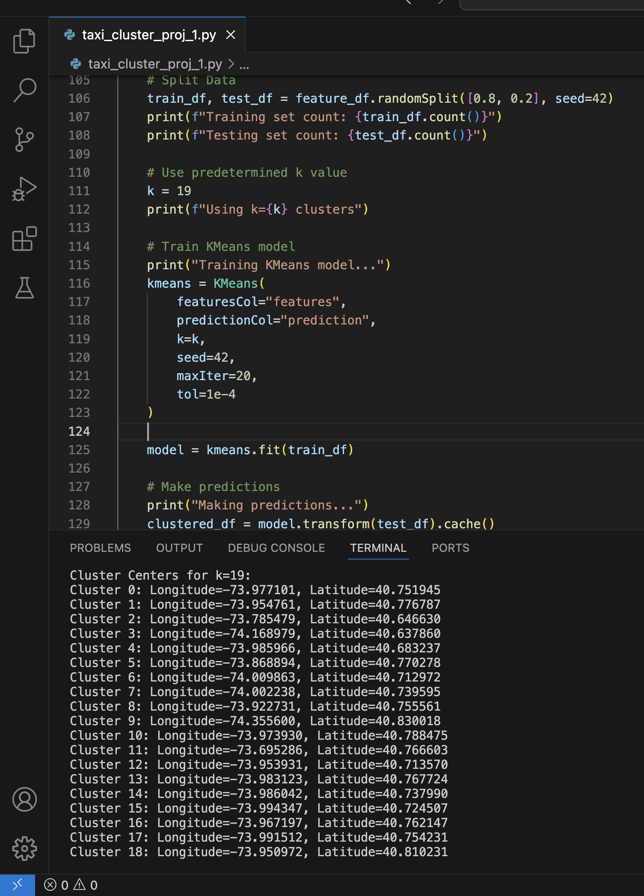
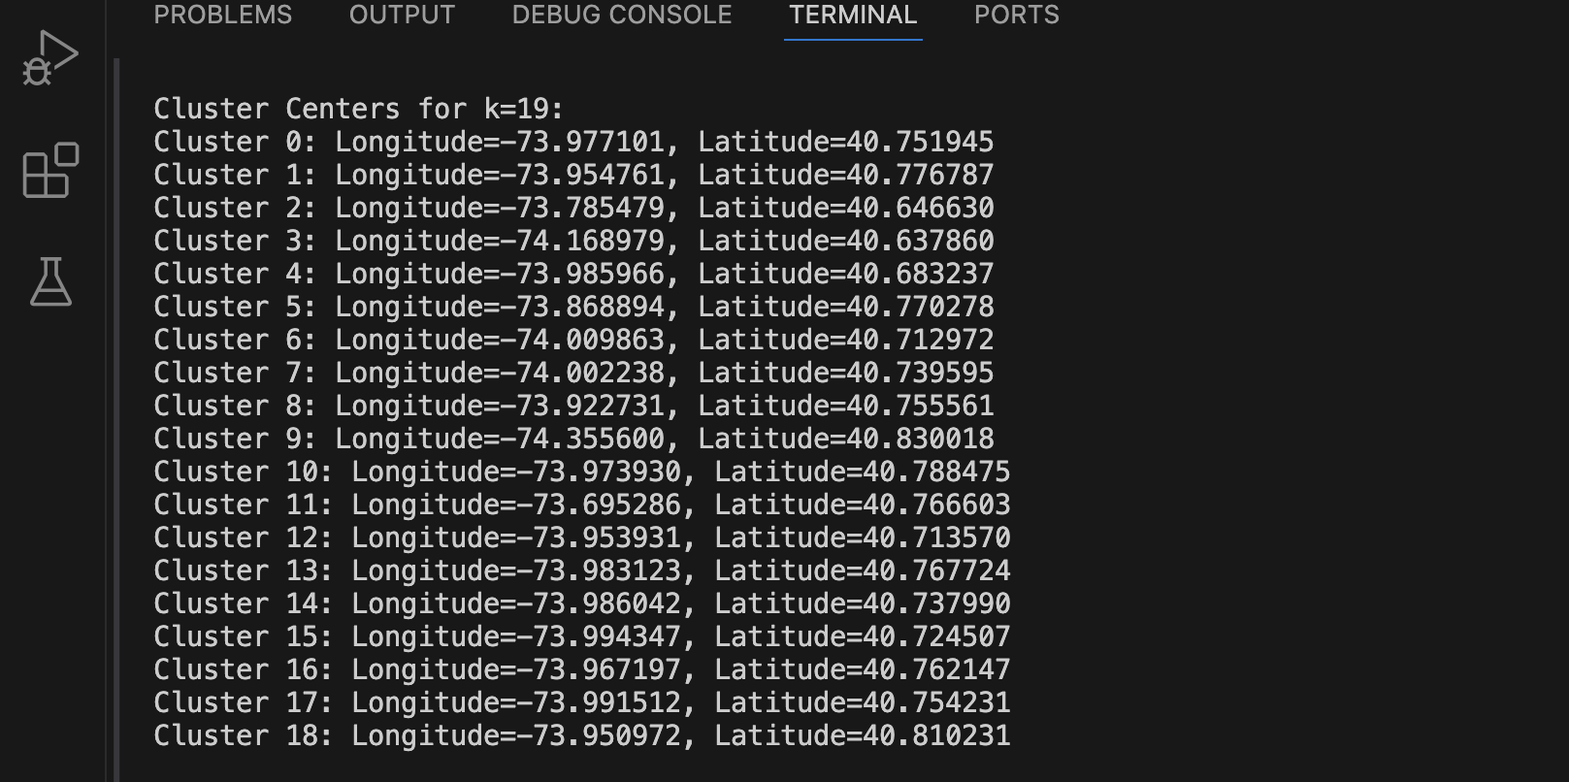
Model & Clusters

Slide 6
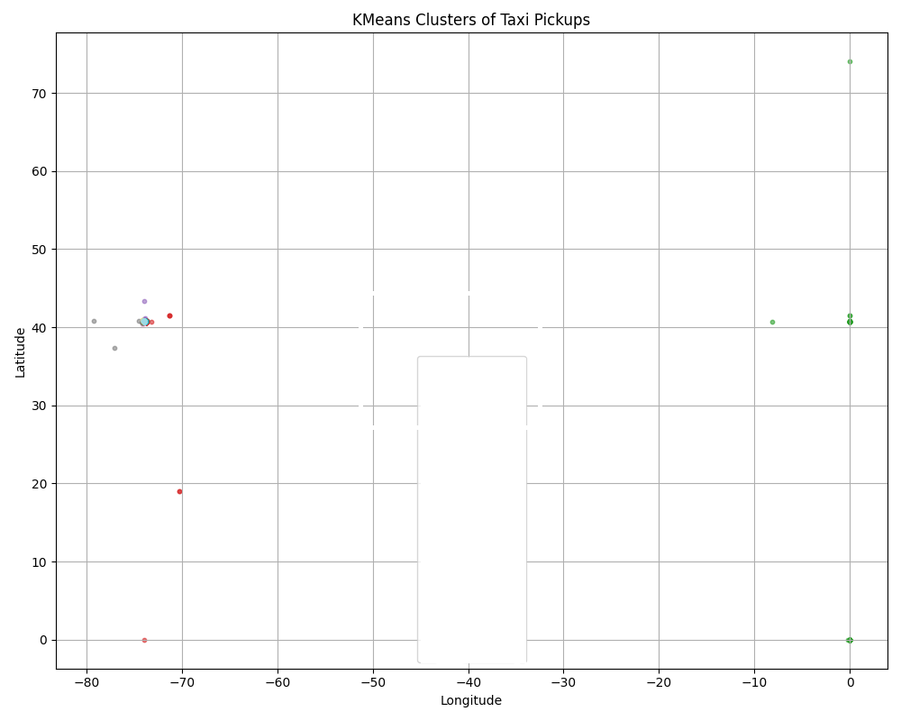
Graph Attempt

Slide 7
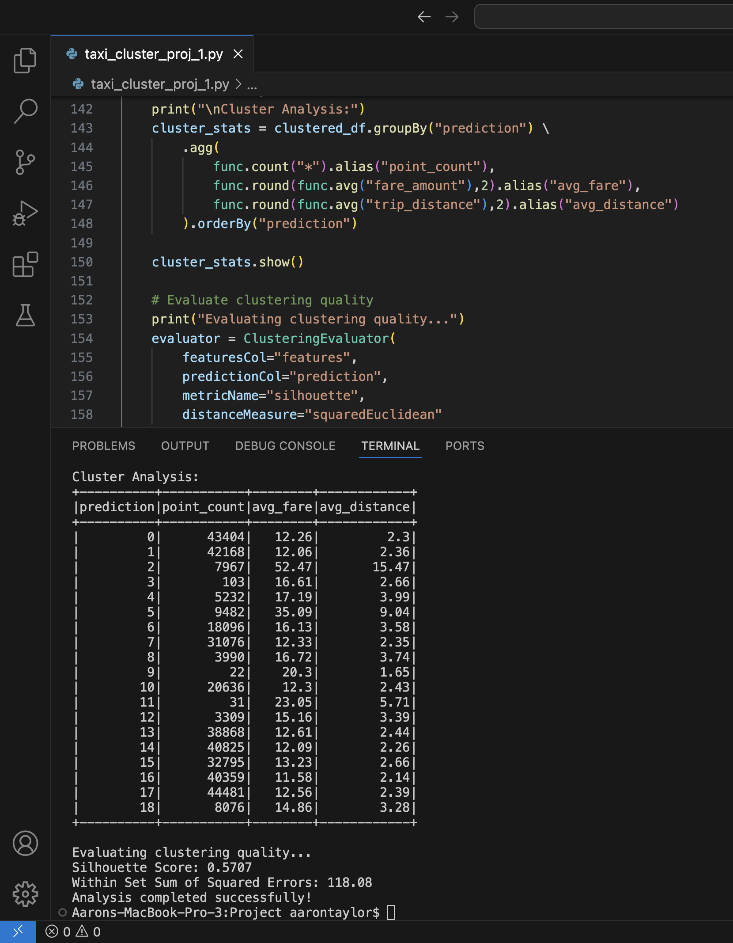
Results
Cluster 2 has the best metrics
Longitude=-73.785479
Latitude=40.646630
Avg Trip Distance: 15.47 miles
Avg Trip Fare: $52.47

Slide 8
Project Continuation
I would like to improve on this model by creating a function to calculate the optimal K-value. There is also room to continue explore by adding in drop-off coordinates to then see where the taxi driver should go next based on that drop-off location.

Slide 9
Sources
https://fritz.ai/mathematics-behind-k-means-clustering/
https://spark.apache.org/docs/latest/api/python/reference/api/pyspark.ml.clustering.KMeans.html
https://en.wikipedia.org/wiki/Silhouette_(clustering)
https://medium.com/analytics-vidhya/clustering-taxi-geolocation-data-to-predict-location-of-taxi-service-stations-pt-1-2471303e0965

Slide 10
Thank You Dr. Trajanov!

